Slide 1
MICROECONOMICS
(BCS 2002 & BSE 2002)/BA]
SPRING-2024
Dr. S. Ghiasul Haq ghiasul786@gmail.com

Slide 2
(D) FACTORS OF PRODUTION
LECTURE-10

Slide 3
1. Factors of Production
The resources used to produce economic goods and services (also called commodities) are called factors of production. The way that these resources are combined to produce the goods and services is called technology. The revenue earned in the process of production is distributed among these four factors of production
There are following four factors of production needed for the creation of goods and services
Land, - Reward RENT (R )
Labor, -Reward WAGES (W)
Capital; -Reward INTEREST (i) ; and
Entrepreneurship -Reward PROFIT (P) [The residual after making to Land, Labor and Capital -P = Net Revenue less (R+W+i)
[Net Revenue is Gross Revenue less material cost]
The total Value added of a firm is always equal to R+W+i+P and for the economy as a whole is called GDP at FACTOR COST
Those who control the factors of production often enjoy the greatest wealth in a society. In capitalism, the factors of production are most often controlled by business owners and investors. In socialist systems, the government exerts greater control over the factors of production. In a mixed economy the share between private businesses and the state may differ according to their political system. (Each factor of production is explained in next slides)

Slide 4
2. LAND
(i) WHAT IS LAND?:
Land refers to all natural resources found in the sea and on land. The range of natural resources has some influence on the capability of the economy to produce different goods and services. Land includes Raw materials e.g. copper, timber and rubber Landscape e.g. mountains, valleys and hills ports e.g. natural harbors Climatic conditions e.g. the seasons geographical location e.g. continents or islands.
(ii) CHARACTERISTICS OF LAND: Land has following SEVEN key features as factor of production:
Free Gift of Nature :Every factor of production which comes under the umbrella of land should have no supply price. To put it differently, land can be used for production without paying any money to the ultimate owner i.e. the mother earth. Further, it requires no human effort.
…Continued Next Slide

Slide 5
……(ii) CHARACTERISTICS OF LAND:
2. Fixed Supply: Land is a strictly the fixed factor of production as land in existence will always remain the same. This means that no amount of change in demand can change the supply of land..Hence we can conclude that the supply of land is perfectly inelastic from the perspective of an economy whereas it is relatively elastic from the perspective of a single firm.
3. The law of diminishing returns: If one factor of production is fixed in supply (e.g. land and / capital in the short run) and extra units of another (i.e. labor ) are added to it, then the extra output or returns gained from the employment of each extra unit of labor must, after a time, go down or diminish.
4. Permanent and has Indestructible Powers : Most of the features related to land are out of the realms of human power. Human being can only degrade or upgrade the characteristics of land up to an extent. The quantity of land and specifically the land itself is indestructible.
…Continued Next Slide

Slide 6
……(ii) CHARACTERISTICS OF LAND:
5. Immobile: Land is a static factor and cannot be shifted be the from their places of origin. For example water, can be taken to another place as a commodity but the whole reservoir of water cannot be shifted to another place
6. Has Multiple Uses: Land can used land in a variety of ways, for various purposes. Hence, land has multiple uses. However, its suitability for all uses is definitely not the same. For instance, a piece of infertile land to set up a factory but may not be not suitable for cultivation.
7. Heterogeneous: Most often no two types of land can be the same. For example, two patches of land can differ in fertility, dimensions, mineral resources are geographically significantly different at different places.

Slide 7
2. RENT DTERMINATION: IN-ELASTIC LAND SUPPLY
LAND SUPPLY
RENT-2
RENT-1
SHIFT IN DEMAND-D2
INTIAL DEMAND-D1
LAND SUPPLY

Slide 8
3. LABOR
WHAT is Labor ?:
Labor is the amount of physical, mental, and social effort used to produce goods and services in an economy done for the sake of reward. It includes all types of human efforts – physical exertion, mental exercise, use of intellect, etc. done in exchange for an economic reward. The supply of labor in a country or the country's labor force refers to all those people who are either employed or seeking employment.
(ii) Characteristics of Labor as a Factor of Production:
Labor is significantly different from other factors of production because it a is living thing. Labor is not only means production but also and end of production. Following are some key features of labor which distinguish it from other factors of production;
(1) Labor is inseparable from laborer himself.
(2) Labor has to sell his labor in person
(3) Labor is extremely perishable and has no reserve price and therefore weak bargaining
power.
(4) The supply behavior of labor is totally different from ordinary supply. At one stage below a certain level the supply of labor my increase and above a certain level it may decline(backward bending). Moreover, most often the supply of labor is inelastic.

Slide 9
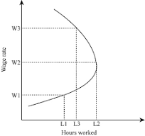
Backward Bending Labor Supply Curve

Slide 10
… 3.DIVISION OF LABOR
When the production of an article is split up into several processes and each process is entrusted to a separate set of workers, it is called division of labor.
Division of labor is classified as:
(1) SIMPLE,
(2) COMLEX and
(3) TERRITORIAL DIVISION OF LABOR
Continued Next Slide…

Slide 11
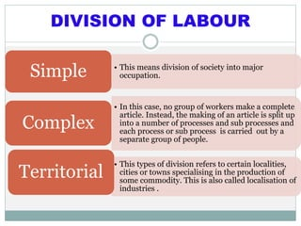

Slide 12
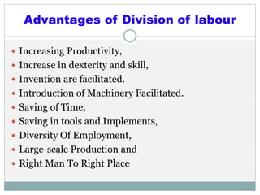

Slide 13
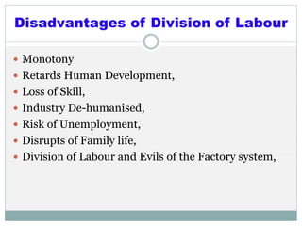
… 3.DIVISION OF LABOR

Slide 14
4.CAPITAL:
Capital is man made source of production used to produce further wealth
It refers to stock of capital assets such as machines, tools & equipment, raw material, transport vehicle etc.…..Therefore Capital is defined as “Produced Means of Production”
In business Capital means amount invested by businessman in the business
In economics Capital is that part wealth which is used for further production

Slide 15
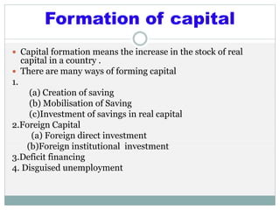
... 4… CAPITAL FORMATION

Slide 16
… 4..RWARD OF CAPITAL -INTEREST
a) INTEREST:
Interest is a payment for the immediate use of a sum of money. But since money is not itself productive, the payment is made in effect for the capital (or means of production) which can be acquired with it.
b) INTEREST RATE DETERMINANTS:
Demand and supply of money determine interest rates. Supply of money is controlled by monetary policy. Demand for money results from transaction demand and asset demand for money (further subdivided in precautionary and speculative demands). Other elements which may affect the interest charged and result in a wide range of values, are: risk level, length of maturity, administrative costs, market imperfections, and inflation rate.
c)IMPORTANCE OF INTEREST:
Interest affects the level of economic activity since it influences consumer purchases and investment decisions. For investment decisions, interest plays a key function in assuring that capital will go where it is most needed.

Slide 17
2. INTEREST RATE - EXOGENOUS MONEY SUPPLY
Money Supply- Tight Monitory Policy
Demand for Money: (Negative Relationship with Interest Rate):
Transaction Demand
Speculative Demand
Pre-Cautionary Demand
Money Supply-
Easy Monetary policy
Interest Rate-20%
Interest Rate-10%
Demand for Money
SUPPLY OF MONEY

Slide 18
…5.ENTERPRIZE & ENTREPRENEUR
DEFINITION: Fourth Factor of Production is Enterprise which is supplied by the Entrepreneur
Entrepreneur is the person who brings or organization other factors of production (LAND, LABOR & CAPITAL) at one place in order to produce goods and services. The Entrepreneur is responsible to take the THREE key economic decisions of :
What to produce;
How to Produce ; and
For Whom to Produce

Slide 19
…5.. ENTREPRENEUR
Following are the key functions of an entrepreneur:
Initiating a business enterprise by mobilizing the necessary productive resources
Taking the final responsibility of the business enterprise-risk-taking and uncertainty bearing.
An entrepreneur is innovator who continuously:
(a) Search and discover economic opportunities;
(b) Evaluate economic opportunities;
(c ) Arrange financial resources necessary for the enterprise,
(d) Make timely decisions; and
Take the ultimate responsibility of management and all kinds
business related risks.

Slide 20
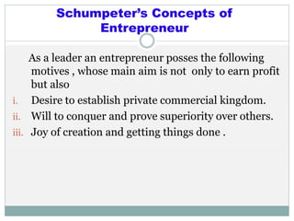
…5.. ENTREPRENEUR

Slide 21
..5. NORMAL & ECONOMIC PROFIT
Profits are essentially the reward for assuming the risk for business.
NORMAL (or Accounting) PROFIT (as already defined) is the Excess of Revenue over kinds of all Explicit Costs. ECONOMIC OR PURE PROFIT is the excess of revenues over all explicit and implicit cost (including the opportunity of the owner of the business to derive income from some other activity).

Slide 22
….5.SUPPLY OF ENTREPRENEURS & PROFIT
AB-NORMAL- PROFIT= S1, E1, M1 O
PROFIT
S1
S 2
E 1
E 3
NORMAL- PROFIT = S2 ,E3 M2 O
Marginal Revenue Productivity
E 2
O
M1 M2
ENTRENEURS

